Slide 2
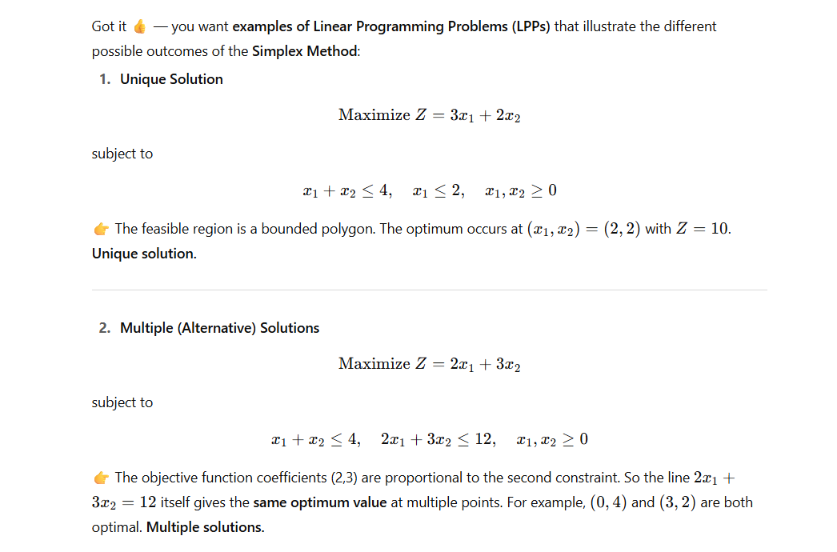

Slide 3
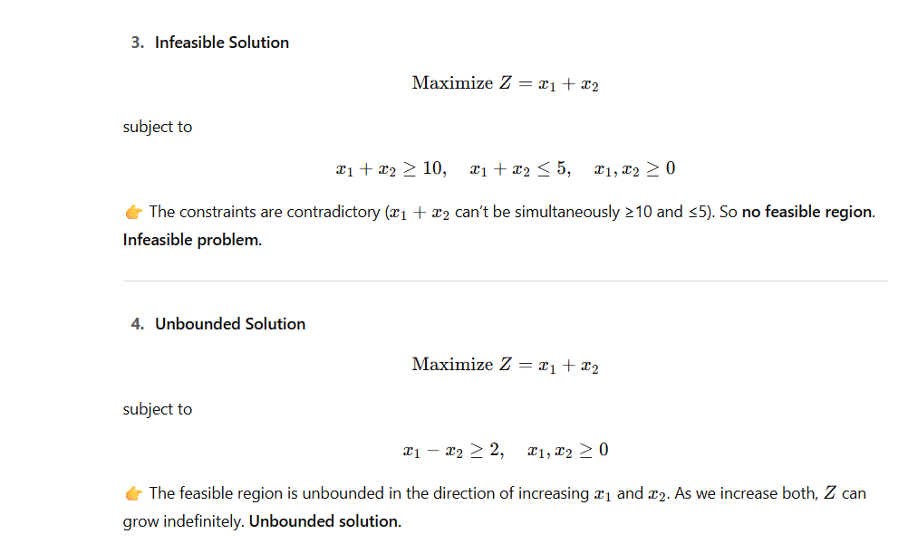

Slide 4
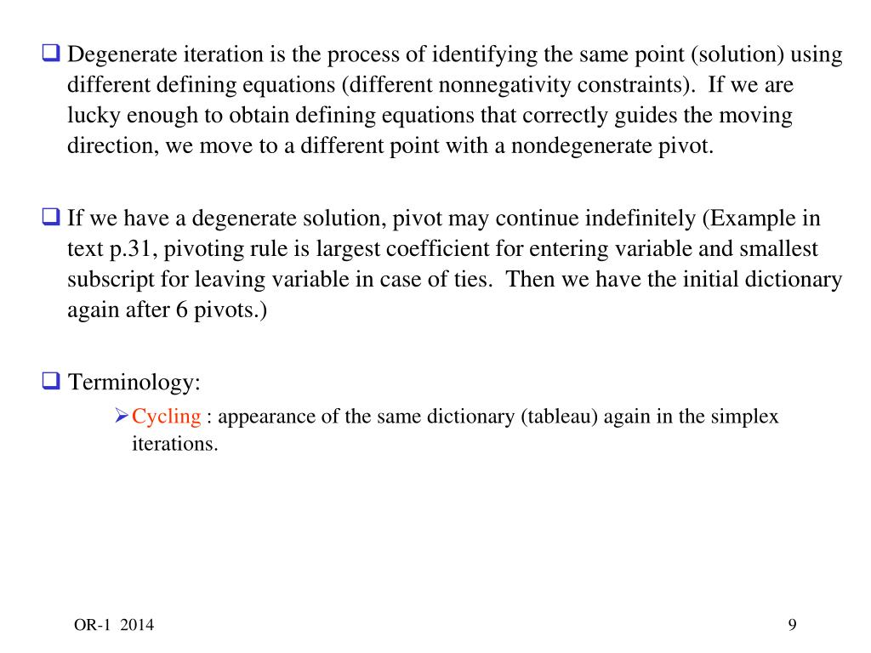
So, what is the problem with degenerate solutions?

Slide 5
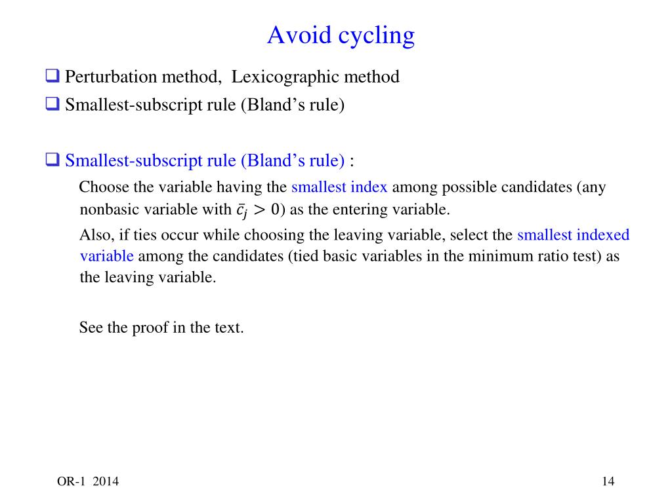
Bland’s rule to prevent cycling

Slide 6
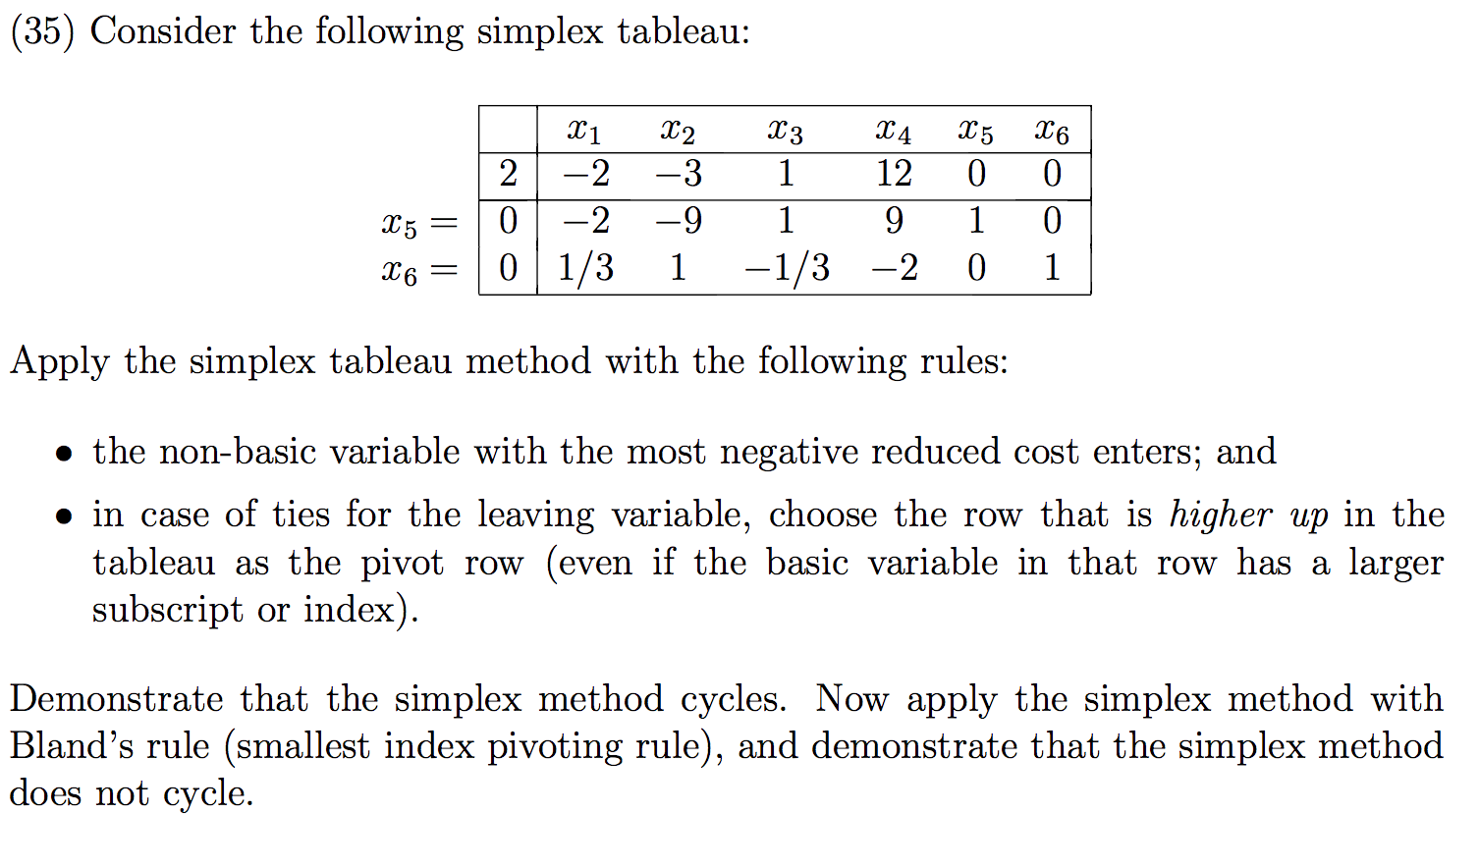
Example

Slide 7
given a final simplex table how can I recognize that this is a multiple solutions, unique solution, infeasible solution, unbounded
Great question 👍 — if you’re only given the final simplex tableau, you can still recognize the type of solution by checking certain conditions. Here’s the checklist:

Slide 8
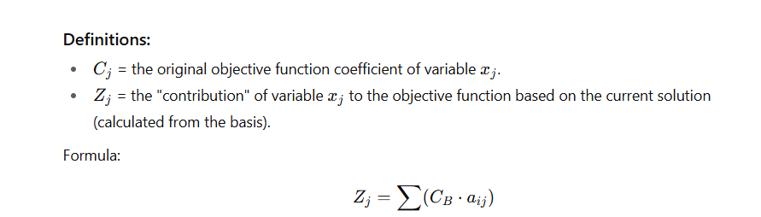
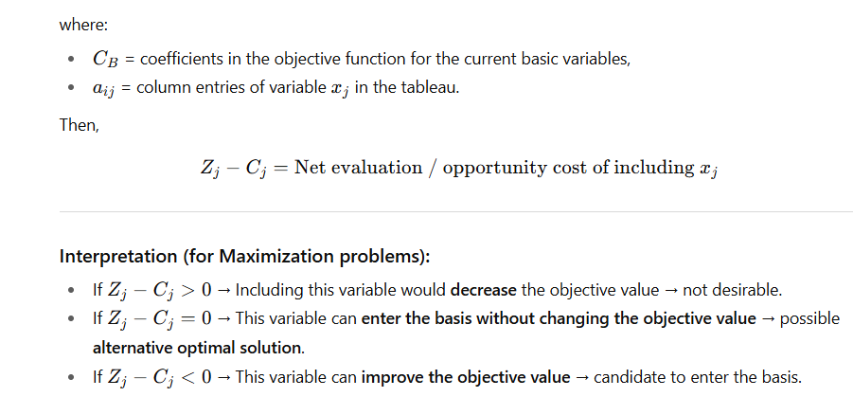

Slide 9
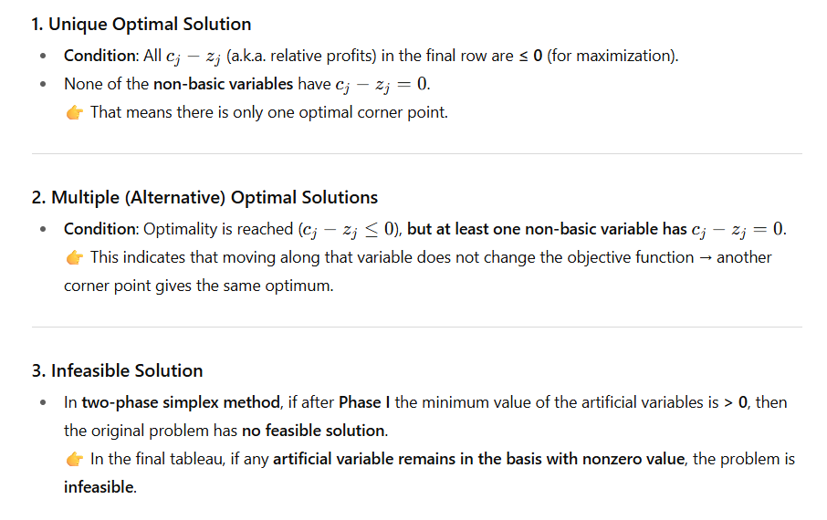

Slide 10
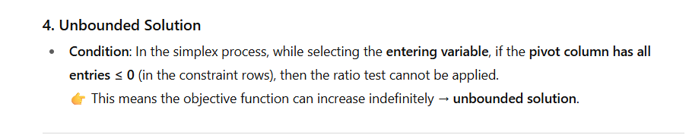

Slide 11
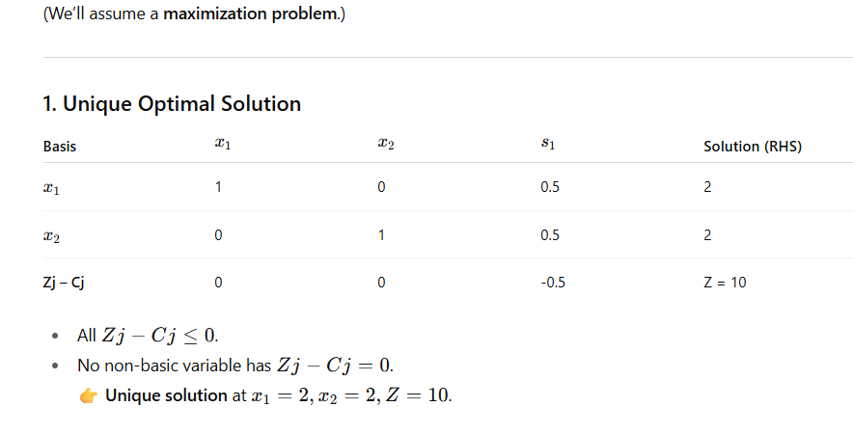

Slide 12
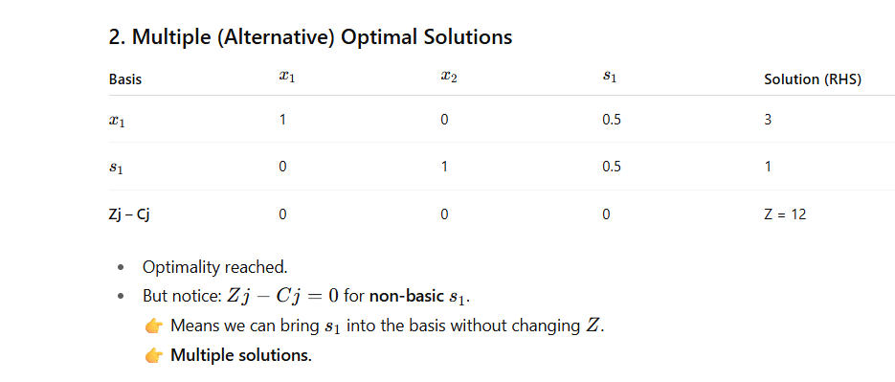

Slide 13
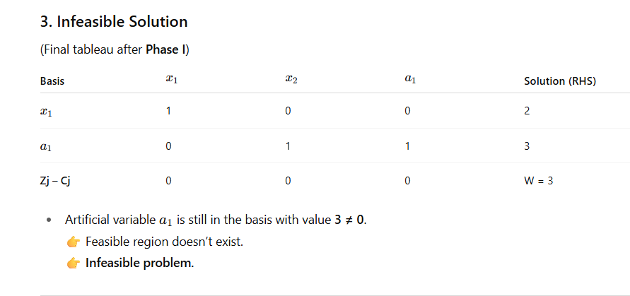

Slide 14
